Slide 1
MINI PROJECT PRESENTATION
SMART HOME DESIGN
BY
K ANANYA (RA2111032010011)
SANGAM SMILIKA REDDY(RA2111032010025)

Slide 2
Abstract
The smart home simulation project investigates the design of a smart home system that automates and controls various household devices. The problem addressed is the need for a reliable and efficient smart home system that can adapt to changing user preferences and environmental conditions.
The smart home simulation project demonstrates the successful development and testing of a working prototype of the smart home system, which demonstrated significant improvements in energy efficiency, convenience, and overall user satisfaction. The machine learning algorithms were found to be particularly effective in optimising the system's performance, leading to further energy savings and improved user experiences.
Overall, the smart home system project utilizes computer communications technology that can provide significant benefits in terms of energy efficiency, convenience, and user satisfaction. The implications of this project are that such systems have the potential to revolutionize the way people interact with their homes and the devices within them, leading to more sustainable and comfortable living environments.

Slide 3
Introduction
The new developing technology that we can see every day in computer, network and control systems make a huge change in our daily life, especially with the exciting Internet Services. Therefore, the Internet of Things plays an important role in managing home sensors, actuators, and devices. Any device or piece of equipment such as multimedia, lighting, and control devices, can be connected to the home network to present new advanced services to the stakeholders. A secure environment, and an efficient comfortable data collecting system coupled with many services such as data manipulation, in addition to a communication system and device automation were significant ideas in the design of a smart home.

Slide 4
Introduction
In recent years, there has been a growing interest in smart homes, which are homes equipped with automated and interconnected systems that can control various household devices and appliances. These systems utilize computer communications technology to provide convenience, ease of use, and energy efficiency to the users. Smart homes can improve the overall living experience of users by providing personalized settings, real-time feedback on device behaviour and energy consumption, and remote access to home systems.
In addition to that, new smart homes try to serve the stakeholder with many control capabilities from inside or outside the home. Such services include exchanging information smoothly, mediating stakeholder lifestyle, arranging the schedule for work in the calendar, managing security and saving money through optimizing energy consumption.

Slide 5
Literature Survey
1. INTRODUCTION
Home is the place where one desires to be after a long tiring day. Some are way too tired that they find it hard to move once they land on their couch, sofa or bed. So any small device/technology that would help them switch their lights on or off, or play their favourite music etc. on a go with their voice with the aid of their smartphones would make their home more comfortable. Moreover, it would be better if everything such as warming the bath water and adjusting the room temperature were already done before they reach their home just by giving a voice command. So, when people would arrive home, they would find the room temperature, and the bath water adjusted to their suitable preferences, and they could relax right away and feel comfortable and rather, feel more homely. Human assistants like housekeepers were a way for millionaires to keep up their homes in the past. Perhaps this is still a solution for the rich in some societies. However, not everyone is wealthy enough to be able to afford a human assistant. Hence, the need for finding an inexpensive and smart assistant for normal families keeps growing. As today’s technology develops, many automatic products and concepts have already come true and can be used at home. Moreover, many of these technologies have the same purpose, which is to reduce people’s work and create a smart environment where people are able to have a better, easier, and more comfortable life.

Slide 6
Literature Survey
2. PRESENT AND FUTURE OF HOME AUTOMATION
Basic automation systems have become a large part of people’s lives today. Systems such as motion sensing, intelligent thermostat control, adaptable luminescence, RFID, biometrics, IR technology, RF technology, and CCTV security have become very common. Advanced automation technology such as user recognition using facial features, voice-controlled commands, assisting in planning, and advising in daily life chores is already implemented. The
popularity of residential automation is growing quickly. According to ABI Research, 1.5 million home automation systems were installed in the US in 2012, and a sharp uptake could see shipments topping over 8 million in 2017. Cisco CEO John Chambers predicts that the market will be worth $19 trillion by 2020. Today, we have a lot of cheap and costly home automation products in the market. Each has a way to communicate with the device controllers. For example, RF-based remotes can turn lights on and off, and a smart plug can be controlled via a smartphone or a tablet, which can later be used to control specific devices. Motion detection has been around, since the 1970s. Opening the door, as soon as someone walks in front of it is a great example of automation. These are a few common examples among a vast majority of diverse, and most importantly, intelligent systems. Most of the world’s top technology companies have been working on developing their own version of home automation technology. The research has been ongoing for a couple of years now. Many of them have either come up with their version of the technology for the general public to buy or have their initial prototypes, ready to be launched soon.

Slide 7
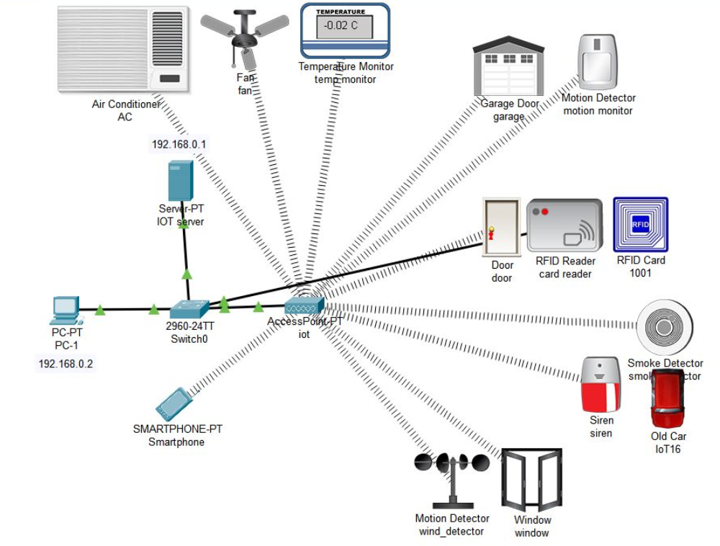
DESIGN WITH MODULES DESCRIPTION
Smart Home Design

Slide 8
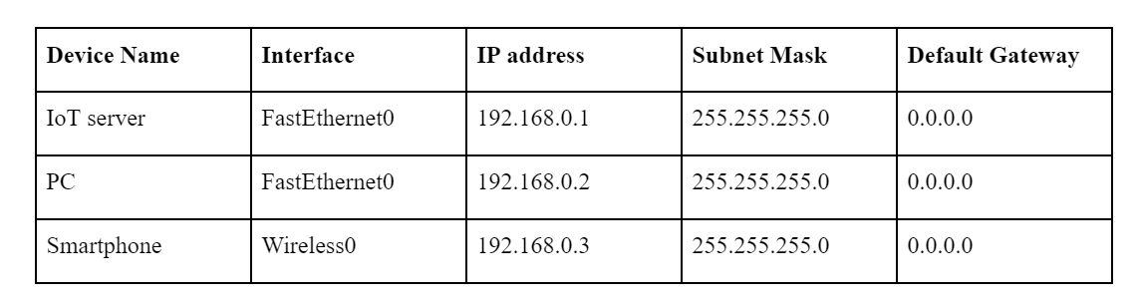
CALCULATIONS AND IMPLEMENTATION

Slide 9
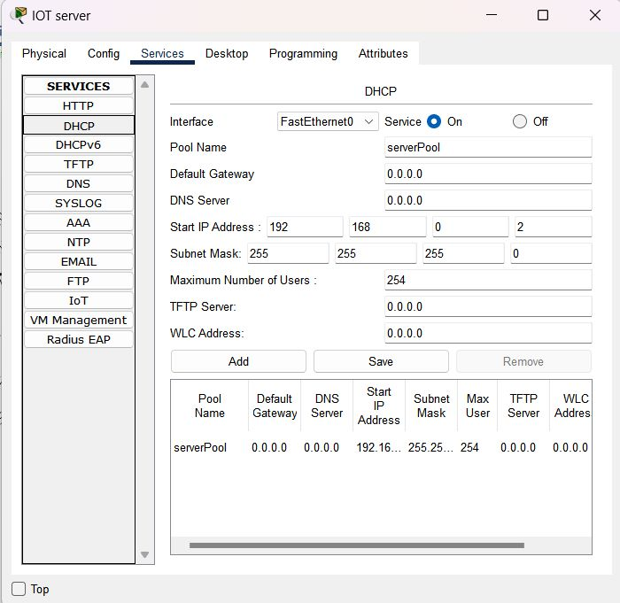
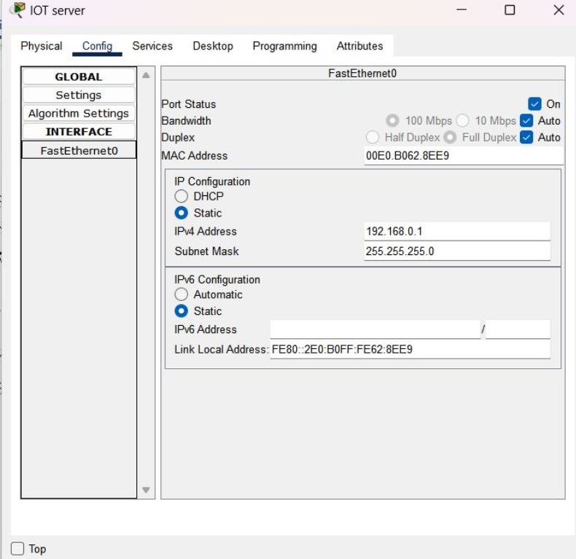
CALCULATIONS AND IMPLEMENTATION

Slide 10
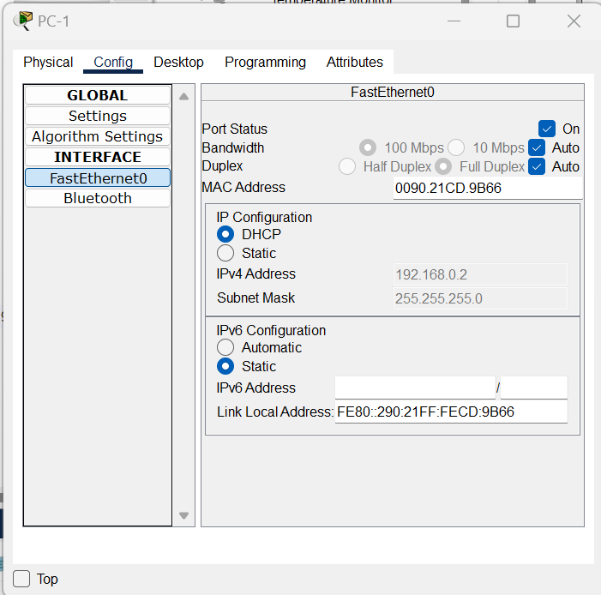
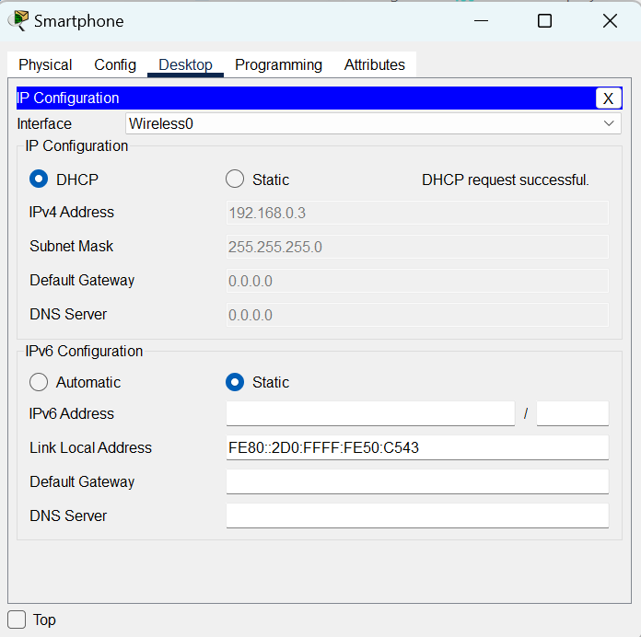
CALCULATIONS AND IMPLEMENTATION

Slide 11
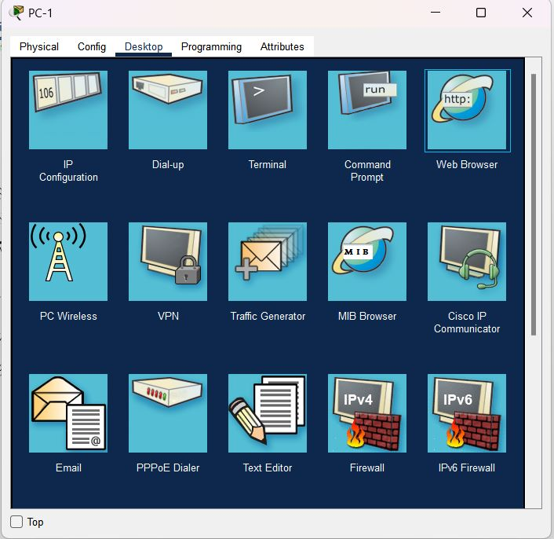
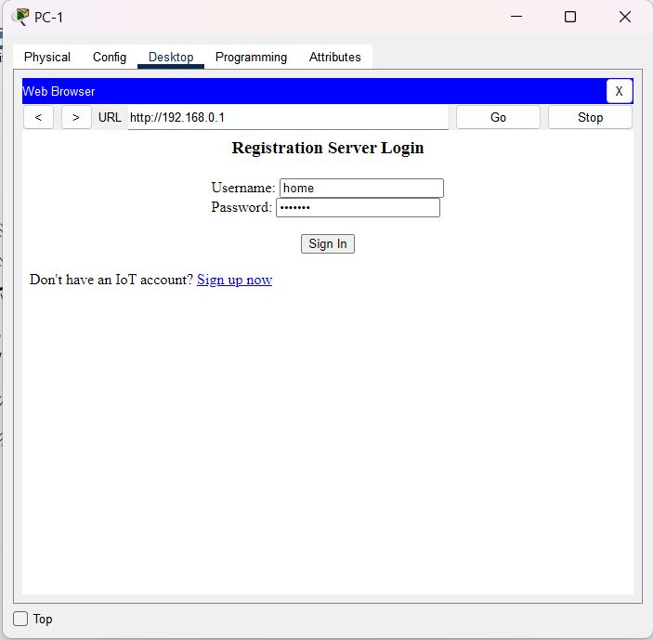
CALCULATIONS AND IMPLEMENTATION

Slide 12
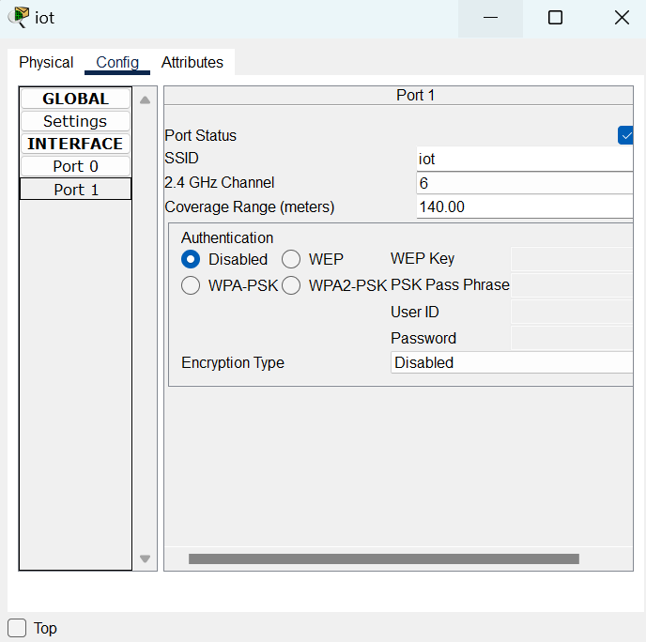
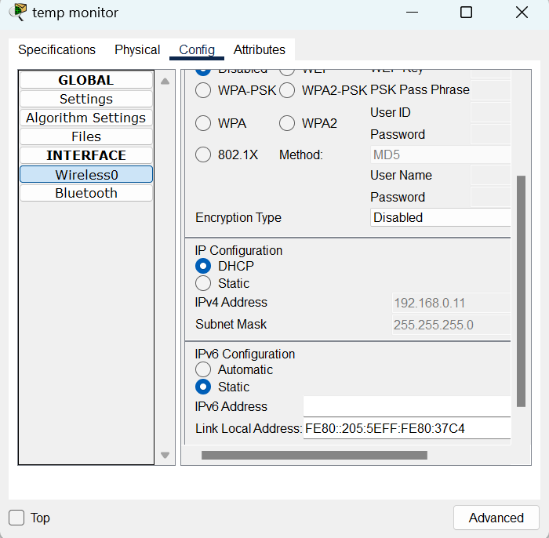
CALCULATIONS AND IMPLEMENTATION

Slide 13
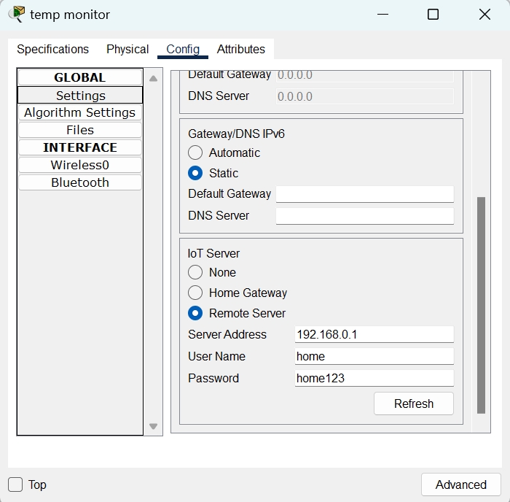
CALCULATIONS AND IMPLEMENTATION

Slide 14
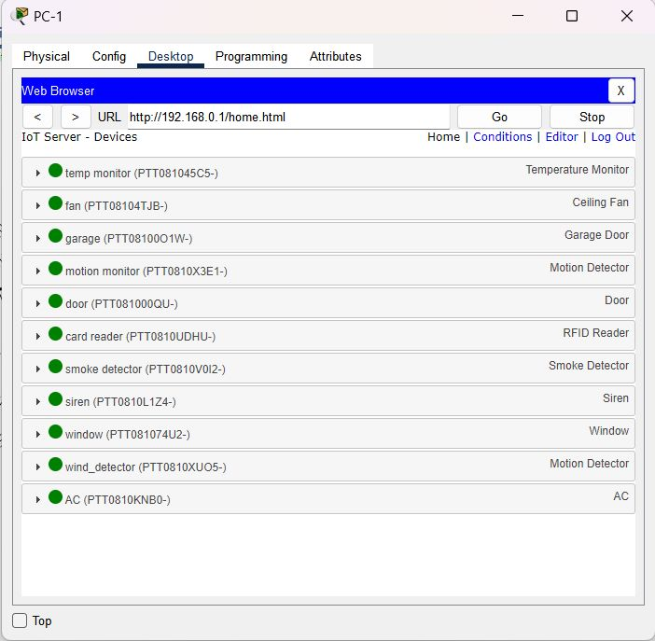
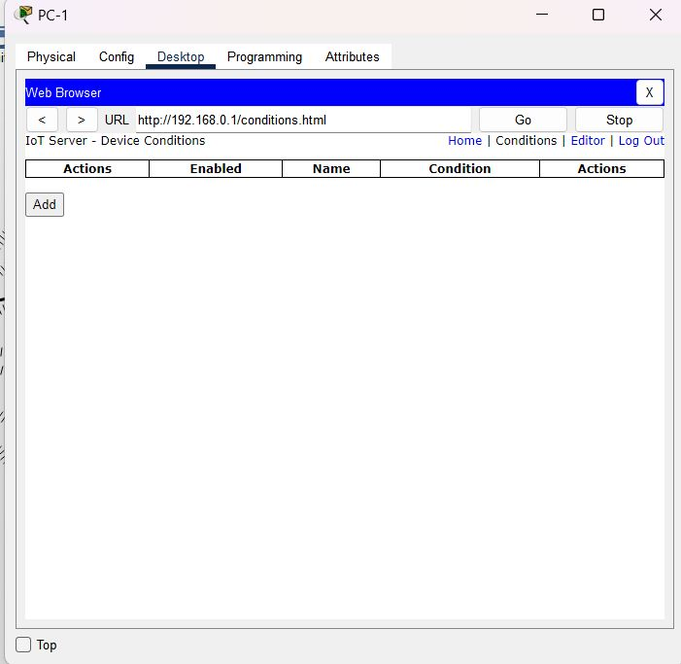
CALCULATIONS AND IMPLEMENTATION

Slide 15
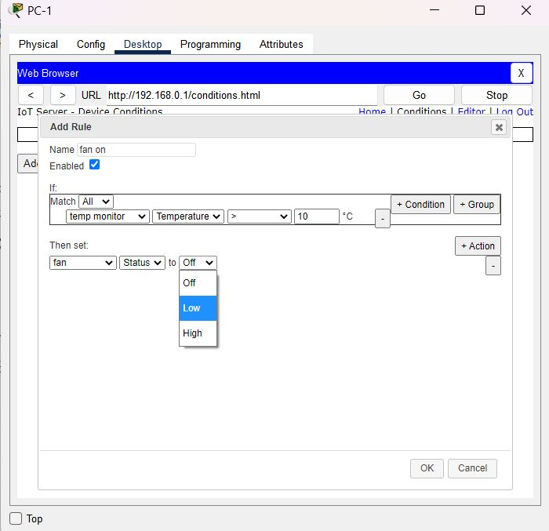
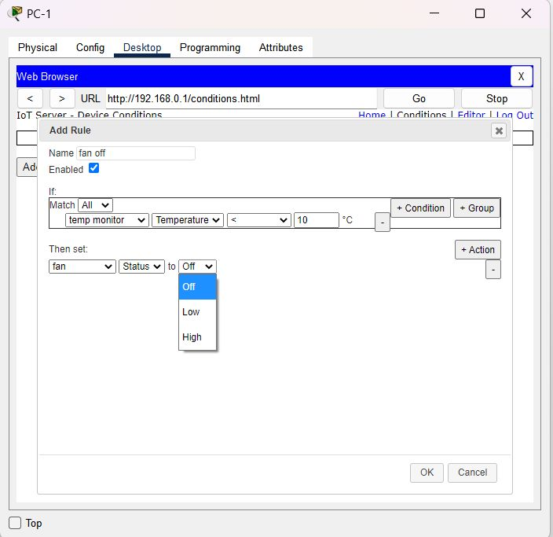
CALCULATIONS AND IMPLEMENTATION

Slide 16
IMPLEMENTATION

Slide 17
Inference
The results suggest that smart home systems have the potential to revolutionize the way people interact with their homes and the devices within them, leading to more sustainable and comfortable living environments. Further research in the field of smart homes is recommended to improve the efficiency and effectiveness of these systems.

Slide 18
Conclusion
In conclusion, this project demonstrates that a smart home system that utilizes computer communications technology can provide significant benefits in terms of energy efficiency, convenience, and user satisfaction. The integration of various sensors and devices into a centralized control system proved to be effective in achieving these benefits. The system was found to be scalable and adaptable, allowing for the addition of new devices and features as needed. The system also provided user-friendly interfaces, personalised settings, and real-time feedback on device behaviour and energy consumption, enhancing the overall user experience.

Slide 19
Result
Thus, IoT-based smart home simulation was successfully designed and implemented in Cisco Packet Tracer.

Slide 20
References
https://elk.adalidda.com/2017/08/L0608016490.pdf
https://www.abiresearch.com/press/15-million-home-automation-systems-installed-in-
https://www.pewresearch.org/internet/2014/04/03/older-adults-and-technology-use/
https://www.irjet.net/archives/V5/i5/IRJET-V5I5924.pdf

Slide 21
Thank you!
PROJECT BY
K ANANYA (RA2111032010011)
SANGAM SMILIKA REDDY(RA2111032010025)

